Slide 1






Movie Popularity Prediction
Group 8
Mengqi CHEN, Sitong CHEN, Xiyao CHEN, Xiaochen FAN, Jike FANG, Ning FU, Tao HAN, Sijie JIN, Xianghong LUO, Yan QIN, Yuhao TIE, Che XU, Siyang XUE, Yixiao ZHANG

Slide 2
CONTENTS
01
Part One
Overview
02
Part Two
Exploratory Data Analysis
03
Part Three
Linear Regression Model
04
Part Four
Non-Linear Model
05
Part Five
Conclusion

Slide 3

01
Part One
Overview

Slide 4
Overview
Purpose: Predict on movies’ ratings.
Model:
Linear Model
Nonlinear Model
Neural Network

Slide 5
Overview – Raw Data
Over 4000 movies, 21 Variables
ID: id - The movie_id | Categorical Variable genre - The genre of the movie, Action, Comedy, Thriller etc original_language - The language in which the movie was made original_title - The title of the movie before translation or adaptation spoken_language - The language in which the movie was released production_companies - The production house of the movie production_countries - The country in which it was produced release_date - The date on which it was released status - "Released" or "Rumored" cast – cast of the movie crew – crew of the movie
Scalar Variable: budget - The budget in which the movie was made revenue - The worldwide revenue generated by the movie runtime - The running time of the movie in minutes vote_average - average ratings the movie received vote_count - the count of votes recieved
Other Variable: homepage - A link to the homepage of the movie keywords - The keywords or tags related to the movie overview - A brief description of the movie tagline - Movie's tagline title - Title of the movie

Slide 6
Overview – Raw Data
Over 4000 movies, 21 Variables
ID: id - The movie_id | Categorical Variable genre - The genre of the movie, Action, Comedy, Thriller etc original_language - The language in which the movie was made original_title - The title of the movie before translation or adaptation spoken_language - The language in which the movie was released production_companies - The production house of the movie production_countries - The country in which it was produced release_date - The date on which it was released status - "Released" or "Rumored" cast – cast of the movie crew – crew of the movie
Scalar Variable: budget - The budget in which the movie was made revenue - The worldwide revenue generated by the movie runtime - The running time of the movie in minutes vote_average - average ratings the movie received vote_count - the count of votes recieved
Other Variable: homepage - A link to the homepage of the movie keywords - The keywords or tags related to the movie overview - A brief description of the movie tagline - Movie's tagline title - Title of the movie

Slide 7

02
Part Two
Exploratory Data Analysis

Slide 8
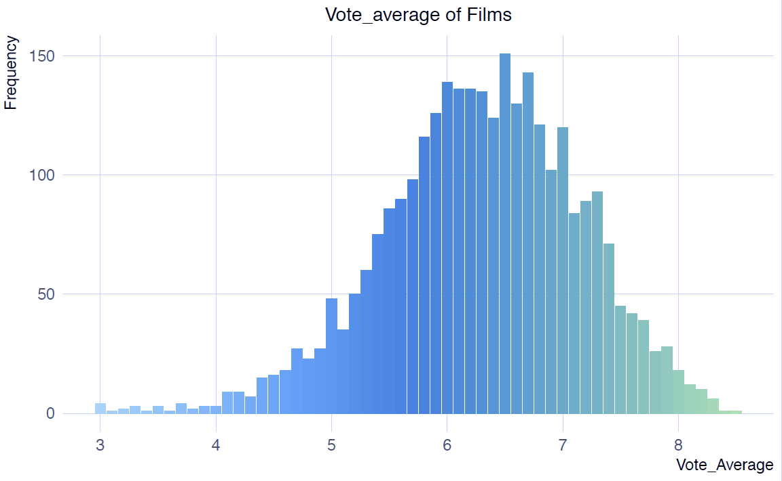
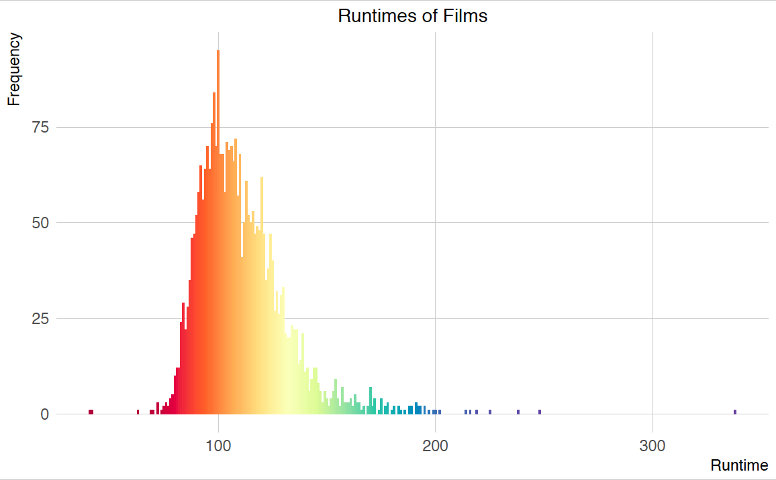
EDA – Vote & Runtime
Vote_average: the average rating a movie received
Vote_count: the number of likes for this movie
Runtime: the running time of the movie in minutes

Slide 9
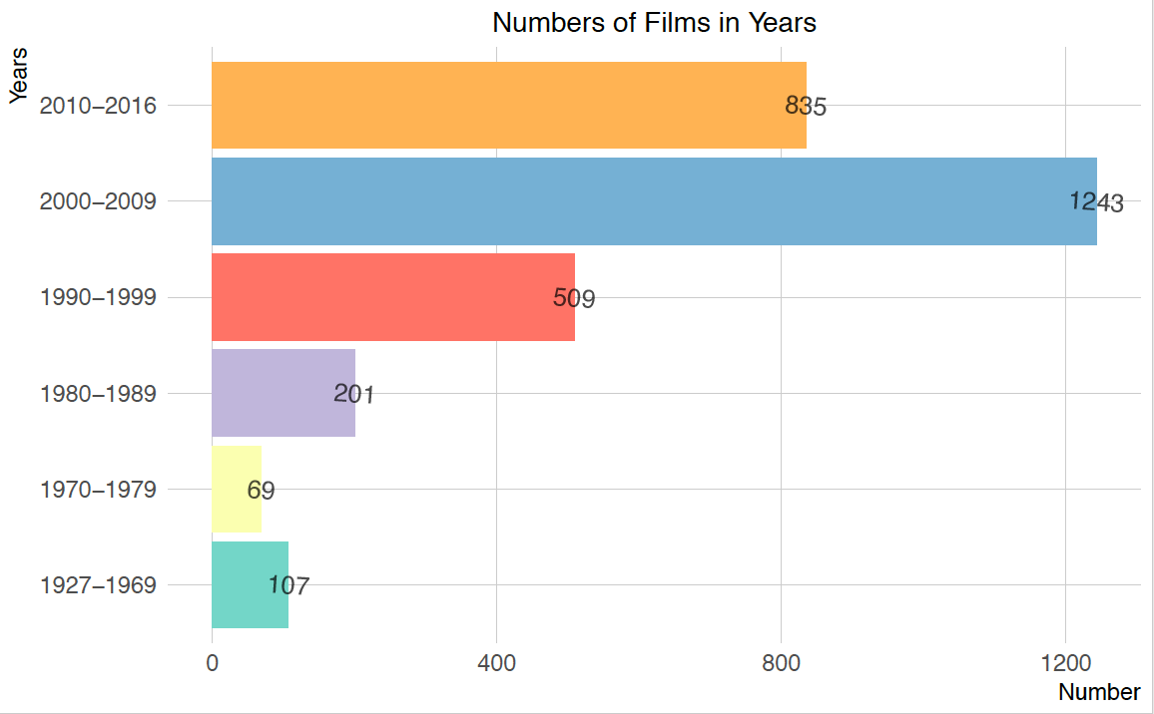
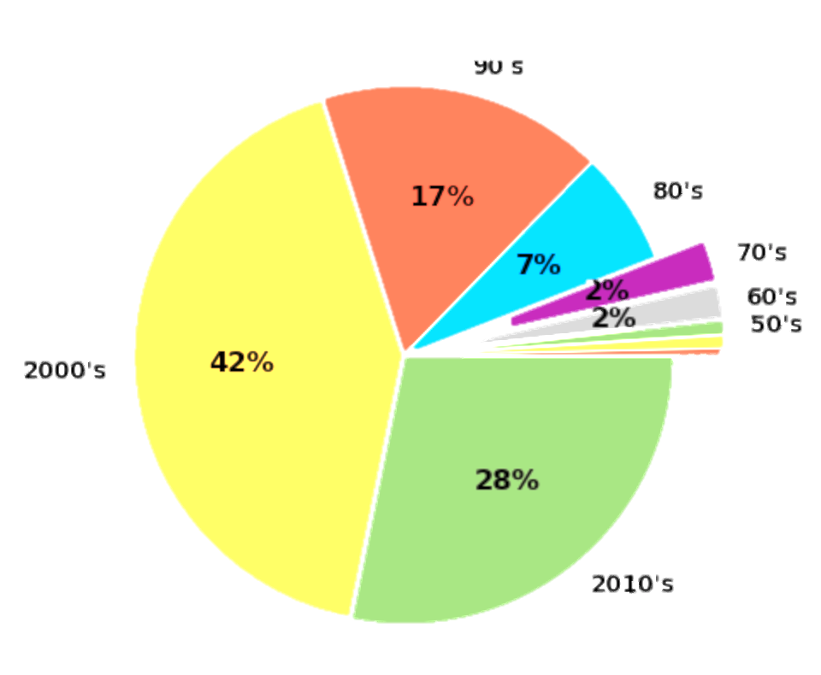
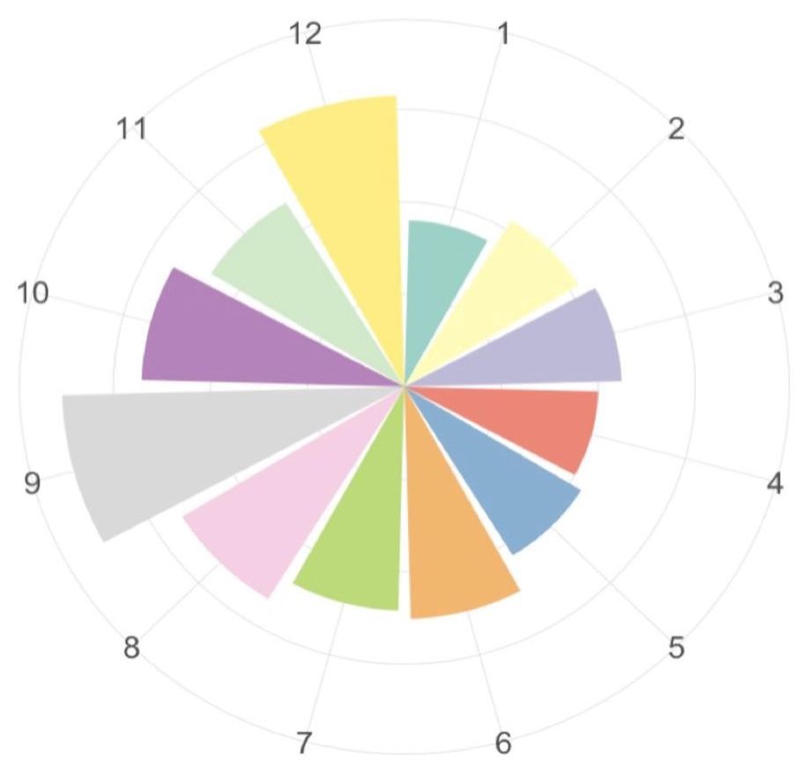
EDA – Time
Month: convert to a factor variable;
month 1 (January) is the reference group.
Year: 1927-2016; spans 89 years; convert to a variable that has value 0 if year = 1927, has value 89 if year = 2016, etc.

Slide 10
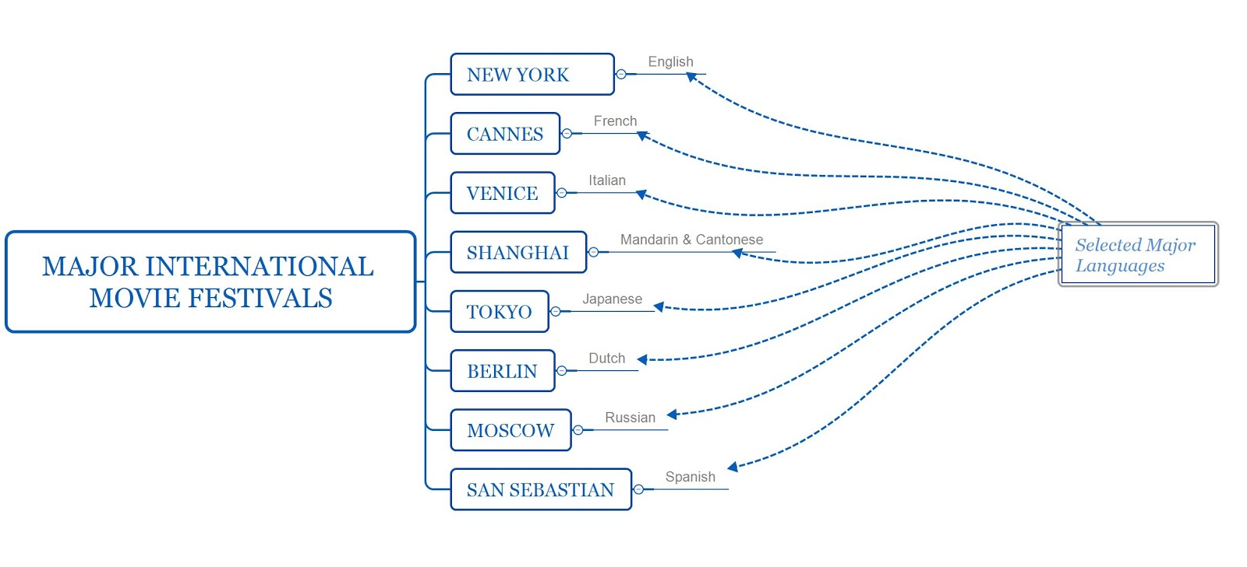
EDA – Spoken Language
Spoken Language: 15 major language are encoded into multi-hot variables.
Min_language: 40 minor languages are compressed in one variable

Slide 11
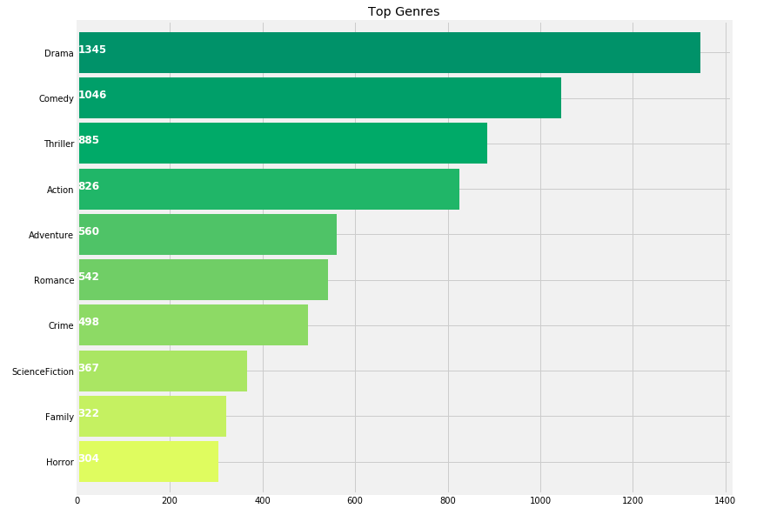
EDA – Genres
Action, Comedy, Thriller etc.
19 genres are encoded into multi-hot variables

Slide 12

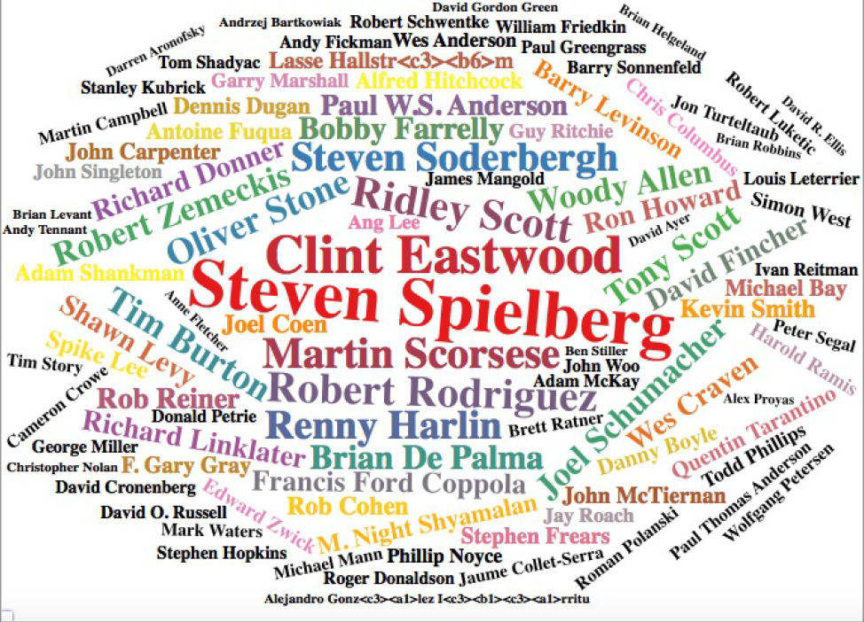
EDA – Director vs Studios
Director: Draw ‘director’ feature from ‘crew’.
Studios
majority_studio: the number of top six production companies that involved in the movie.
minority_studio: the number of other production companies that involved in the movie.

Slide 13
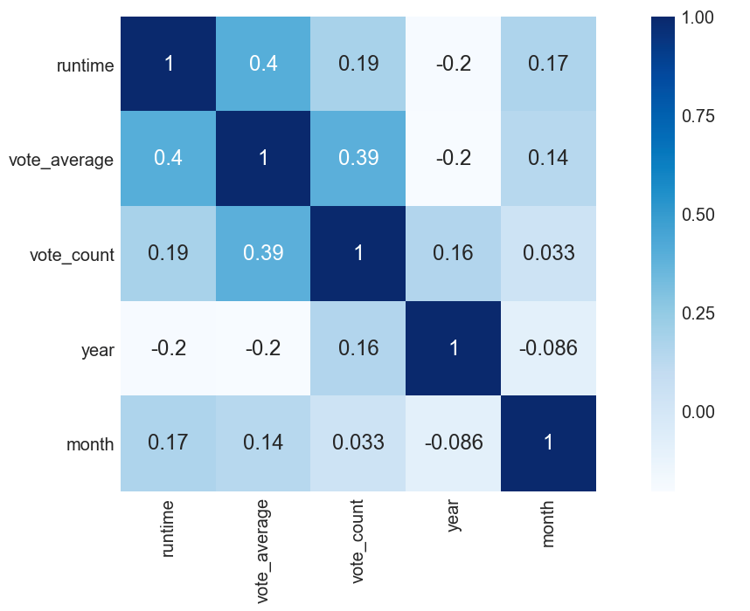
EDA – Correlation between Variables

Slide 14
03
Part Three
Linear Regression Model

Slide 15
Datasets
VIFs of predictors in our dataset are very small and less than 10
no collinearity is detected
Training data: include 75% of the cleaned data
Testing data: include 25% of the cleaned data
We train models on training data and assess their performances using testing data.

Slide 16
Linear Regression Model
Model Selection
Stepwise selection using AIC
LASSO L1 regularization
41 predictors, large p
Diagnosis of underlying assumptions
Linearity
Normality
Homoscedasticity:
Uncorrelated Variance
Corrective Measures
Transformation: Log, Box-cox
Build WLS
Ridge

Slide 17
Linear Regression Model – Model Selection (Stepwise)
OLS model:
The final model has the smallest AIC
Vote_average ~ runtime + vote_count + year + month + Documentary + Crime + Foreign + Adventure + Action + Comedy + Science.Fiction + Fantasy + Drama + Animation + Family + Horror + L4 (Russian) + L9 (Dutch) + L15 (English) + L50 (Cantonese) + L53 (Thai) + min_language + majority_studios + minority_studios
(24 predictors in total)

Slide 18
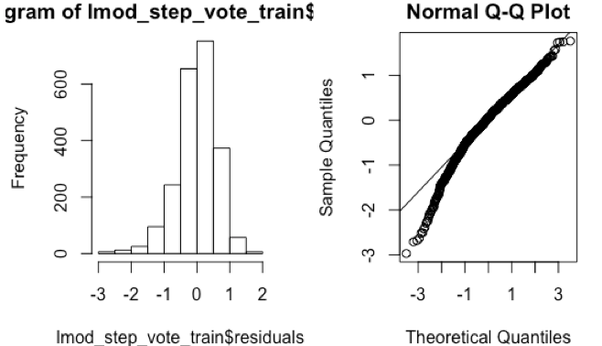
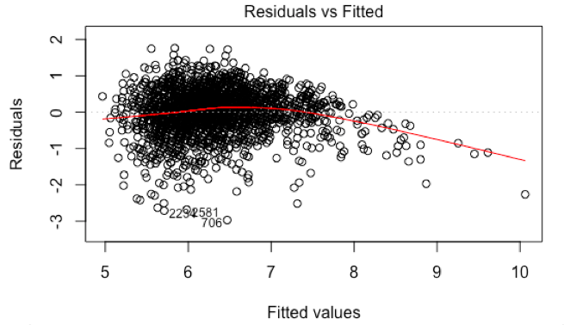
Linear Regression Model – Diagnostics
Linearity & functional form
R-squared: 0.48
Normality
Homoscedasticity
Breusch-Pagan test against heteroskedasticity:
p-value = 0.000627 < 0.05
Score Test for Non-Constant Error Variance:
p-value = 0.010083 < 0.05
Uncorrelated error
Durbin-Watson test: p-value = 0.626 > 0.05
Outliers and influential points
Bonferroni Outlier Test：706, 2234, 2581, 357 are detected
Plot Cook’s distance: 2244, 2132, 182 are highly influential
points.
Most assumptions fail, Need transformation!!

Slide 19
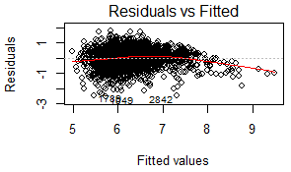
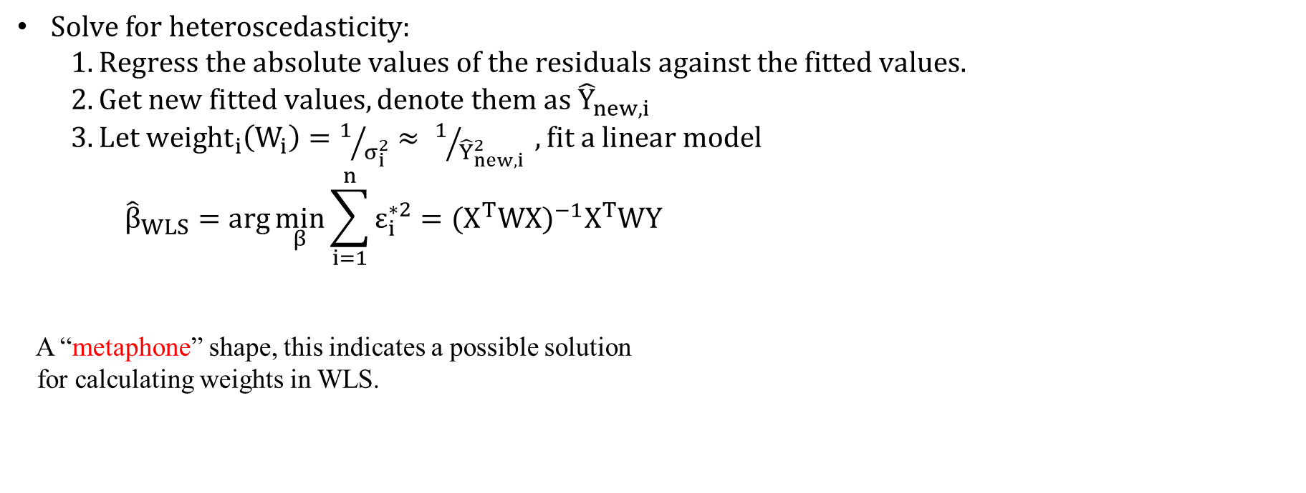
Linear Regression Model – Weighted Least Squares
$Solve for heteroscedasticity:$
$$1. Regress the absolute values of the residuals against the fitted values.$$
$2. Get new fitted values, denote them as {\hat{Y}}_{new,i}$
$3. Let {weight}_{i}\left(W_{i}\right)=1/{σ_{i}^{2}}≈ 1/{{\hat{Y}}_{new, i}^{2}} , fit a linear model$
$${\hat{β}}_{WLS}=arg\min_{β}{\sum_{i=1}^{n}{ε_{i}^{∗2}}}={(X^{T}WX)}^{−1}X^{T}WY$$
A “metaphone” shape, this indicates a possible solution
for calculating weights in WLS.

Slide 20
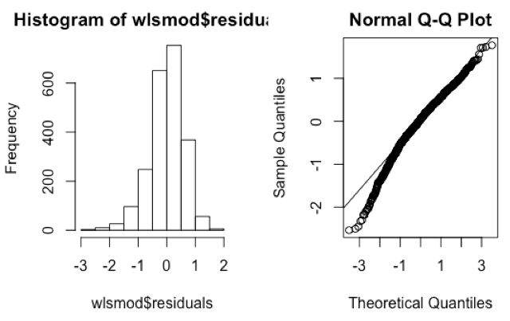
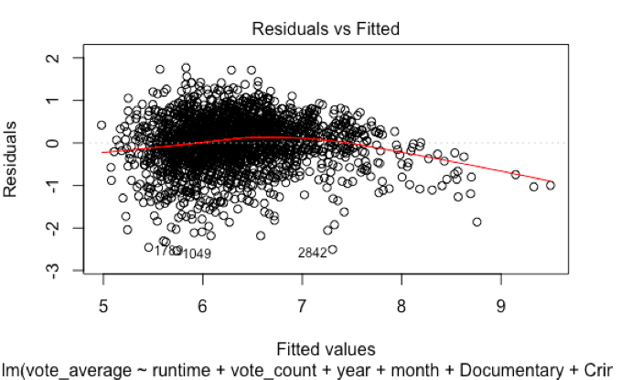
Linear Regression Model – Diagnostics
Remove extreme points and fit WLS
Diagnostics after building WLS
Linearity & functional form
R-squared: 0.5
Normality
Homoscedasticity
Score Test for Non-Constant Error Variance: p-value = 0.61733 > 0.05
Most error variances look constant from residuals vs fitted value plot.
Uncorrelated error
Durbin-Watson test: p-value = 0.982 > 0.05
Outliers and influential points
Bonferroni Outlier Test: Only “2842” is detected
Plot Cook’s distance: No influential points.
All Assumptions hold!

Slide 21
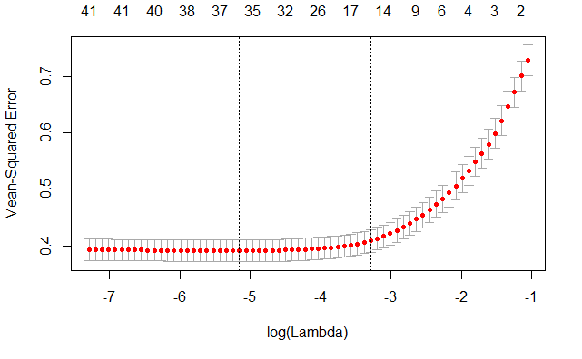
Linear Regression Model – Model Selection (LASSO)
Selected Variables: runtime, vote_count, year, month, Documentary, Crime, Foreign, War, Adventure, Western, Music, Mystery, Action, Comedy, Science.Fiction, Romance, Fantasy, Drama, Animation, Family, Horror, L4, L6, L9, L10, L12, L13, L15, L33, L50, L52, L53, L54, min_language, majority_studios and minority_studios. (36 predictors in total)

Slide 22
Linear Regression Model – Diagnostics & Weighted Least Squares
Diagnostics
Linearity and Uncorrelated errors hold
Normality and Homoscedasticity are violated
Same extreme points are detected
Transformation
Log, Box-cox can’t solve for unequal error variance
WLS
All Assumptions hold!

Slide 23
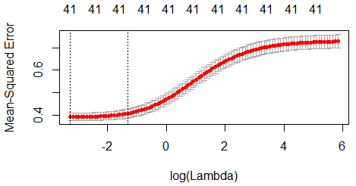
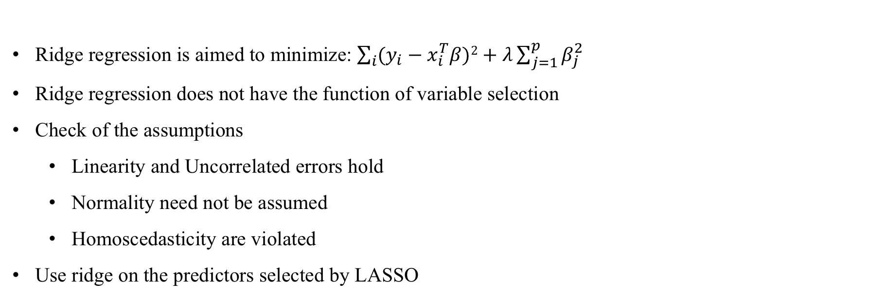
Linear Regression Model – Ridge Regression
Ridge regression is aimed to minimize: $\sum_{i}{(y_{i}−x_{i}^{T}β})2+λ\sum_{j=1}^{p}{β_{j}^{2}}$
Ridge regression does not have the function of variable selection
Check of the assumptions
Linearity and Uncorrelated errors hold
Normality need not be assumed
Homoscedasticity are violated
Use ridge on the predictors selected by LASSO

Slide 24
04
Part Four
Non-Linear Model

Slide 25
Nonlinear Model
Simple Tree Model
Random Forest
Xgboost

Slide 26
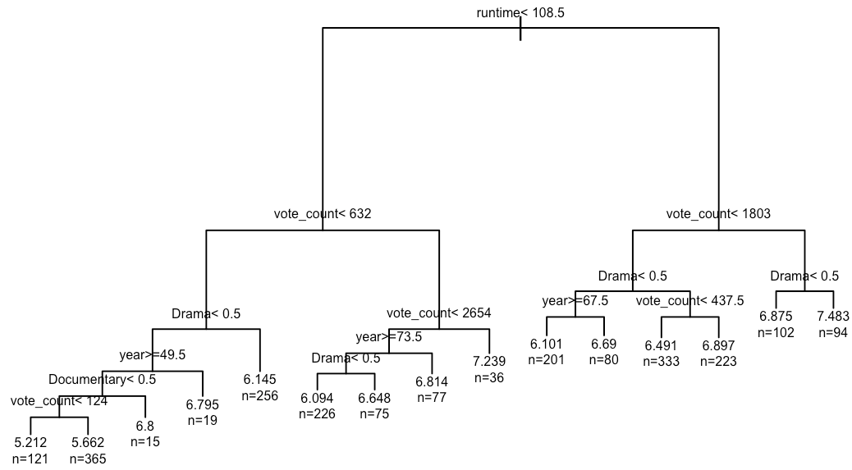
Nonlinear Model – Simple Tree Model
Parameters:
Depth: 8
Split: 20
CP: 1%

Slide 27
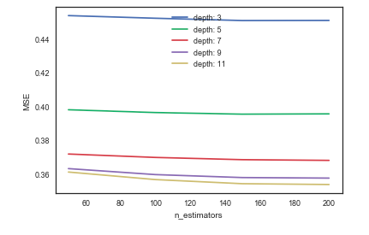
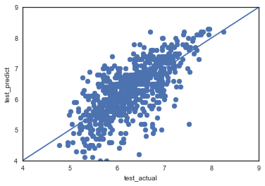
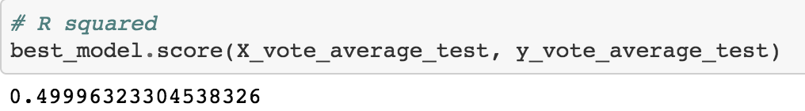
Nonlinear Model – Random Forest
Model selection:
Max_depth = 11
N_estimators = 150

Slide 28
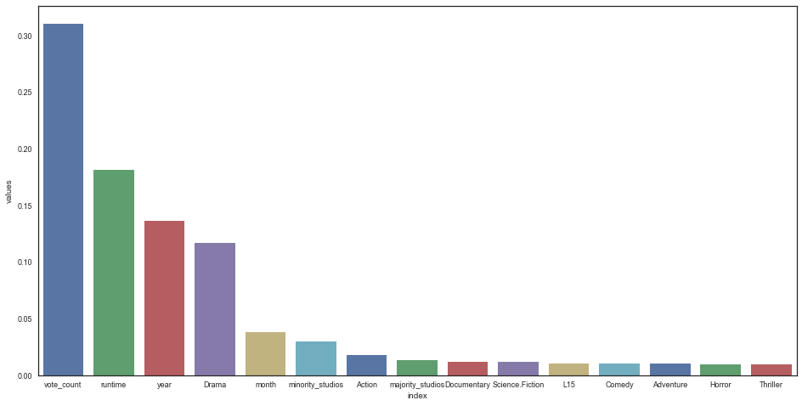
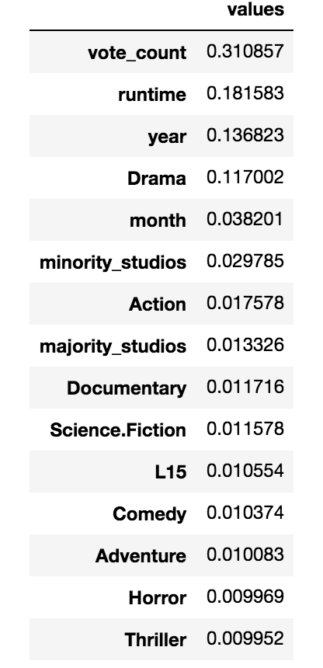
Nonlinear Model – Random Forest
Feature Importance

Slide 29
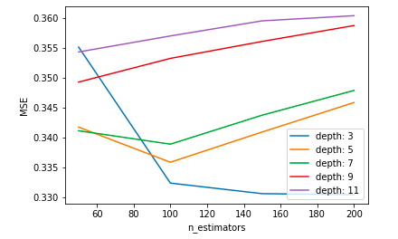
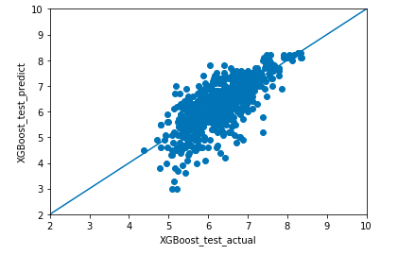
Nonlinear Model – XGBoost
Model selection:
Max_depth = 3
N_estimators = 200

Slide 30
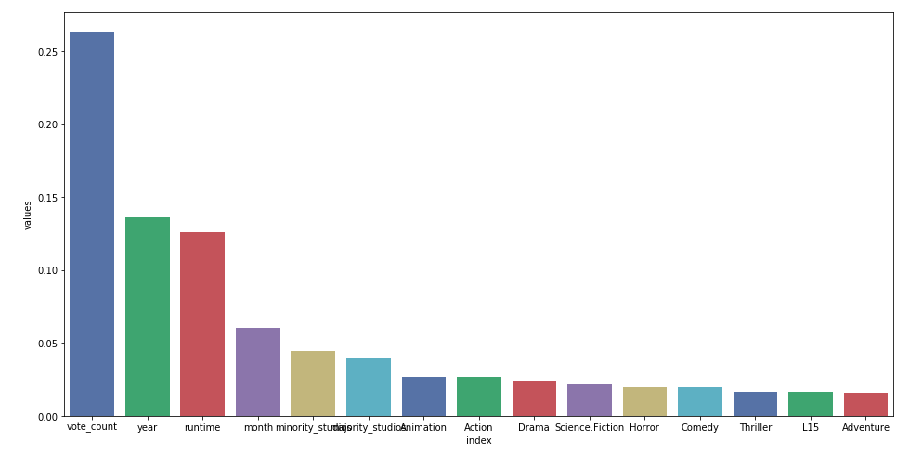
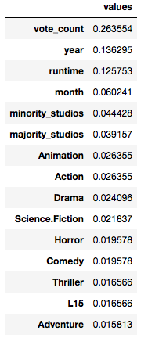
Nonlinear Model – XGBoost
Feature Importance

Slide 31
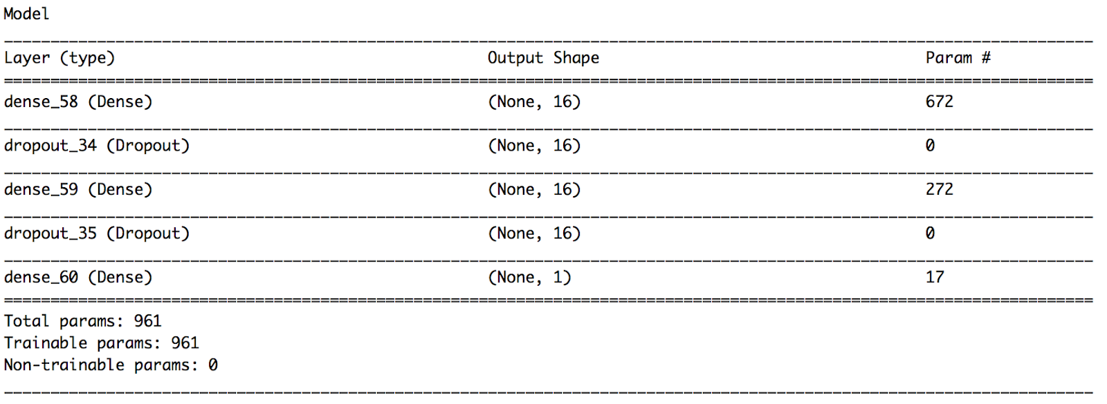
Neural Network
Model specification
Two hidden dense layers followed by dropout layers
16 neurons each

Slide 32
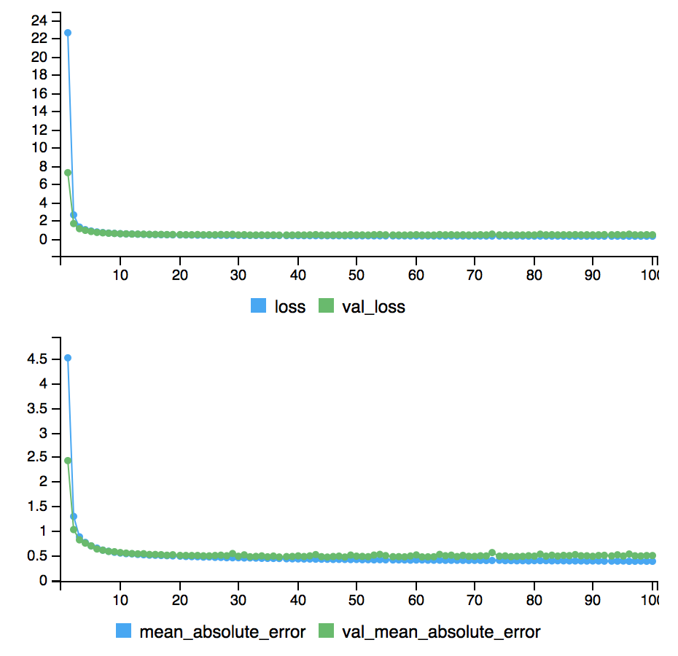
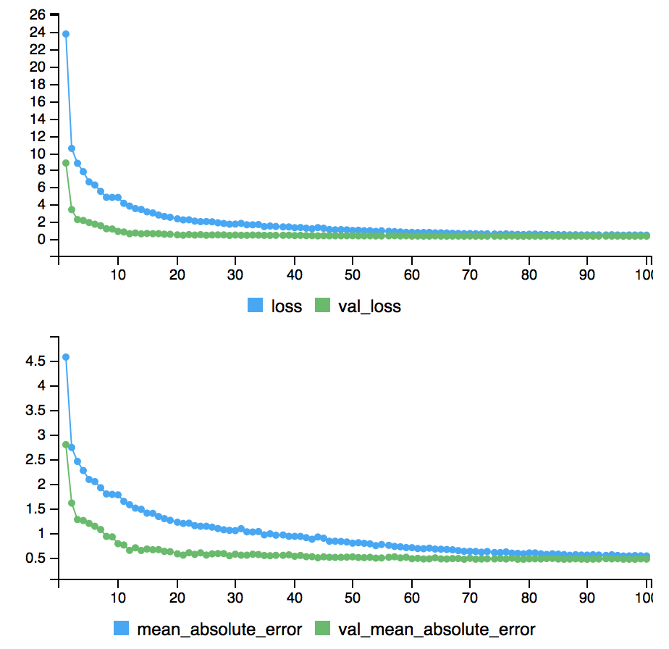
Neural Network
Training without regularization
Overfitting
Training with regularization (dropout)
Small improvement
Overfitting persists
Test error similar to that of slm

Slide 33

05
Part Five
Conclusion

Slide 34

Model Comparison
Test Error (MAPE)
$MAPE= \frac{100\%}{n}\sum_{t=1}^{n}{\left|\frac{A_{t}−F_{t}}{A_{t}}\right|}$
Models | Test Error (in %)
Weighted Least Square (AIC) | 8.37%
Weighted Least Square (LASSO) | 13.43%
Ridge | 8.41%
Tree Model | 9.60%
Random Forest | 8.21%
Xgboost | 7.83%
Neural Network | 8.21%

Slide 35
Conclusion
Xgboost is the best model based on MAPE measurement
It can learn complex non-linear decision boundaries via boosting.
It is optimized for sparse input.
It has an additional custom regularization term in the objective function, which helps prevent overfitting.
Further Study
Interpret models back to the real world
Get a different testing data
Predict upcoming movies’ vote average, find prediction accuracies
Movies released in November

Slide 36




Thank You!
Q & A

